Slide 1
Point-to-Point - II
Lecture 5
January 22, 2024

Slide 2
Send/Recv Example
if (myrank == 0)
MPI_Send (buf, count, MPI_INT, 1, 1, MPI_COMM_WORLD);
else
if (myrank == 1)
MPI_Recv (buffer, count, MPI_CHAR, 0, 1, MPI_COMM_WORLD, &status);

Slide 3
Send/Recv Example
if (myrank == 0)
MPI_Send (buf, count, MPI_INT, 1, 1, MPI_COMM_WORLD);
else
if (myrank == 1)
MPI_Recv (buffer, countchar, MPI_CHAR, 0, 1, MPI_COMM_WORLD, &status);

Slide 4
Send/Recv Example
int buf[100], count=10;
if (myrank == 0)
MPI_Send (buf, count, MPI_INT, 1, 1, MPI_COMM_WORLD);
else
if (myrank == 1)
MPI_Recv (&buf[10], count, MPI_INT, 0, 1, MPI_COMM_WORLD, &status);

Slide 5
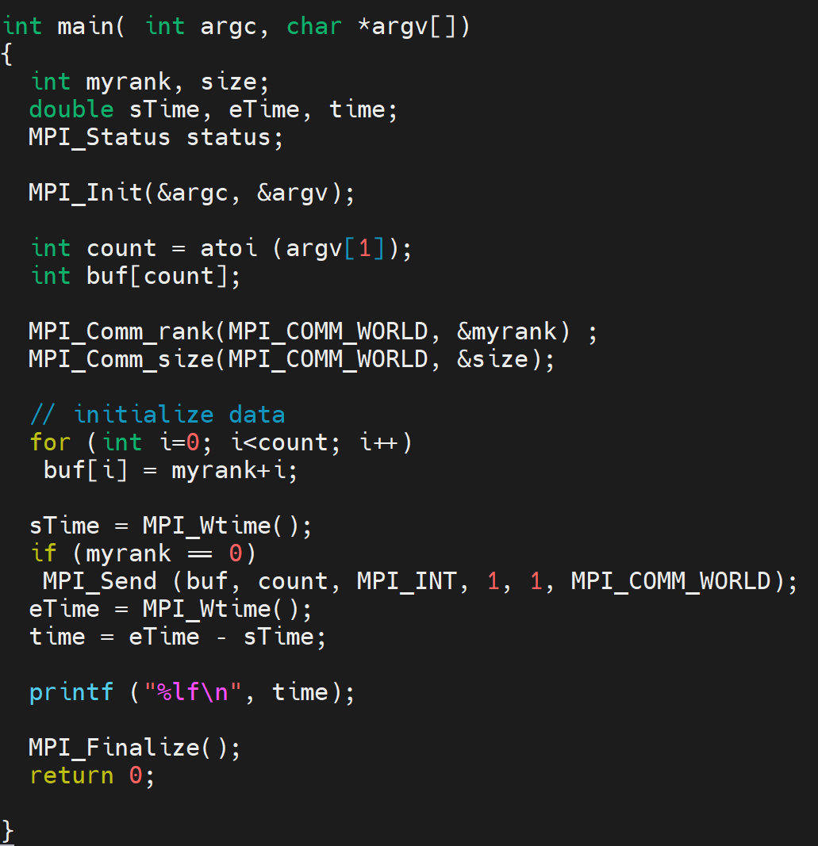
0.000000
0.000002

Slide 6
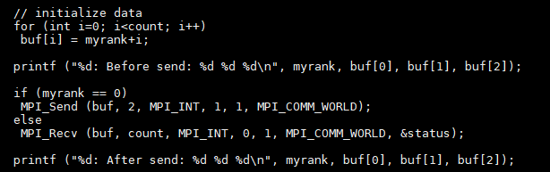
MPI_Recv Example
mpirun -np 2 ./a.out 100
0: Before send: 0 1 2
0: After send: 0 1 2
1: Before send: 1 2 3
1: After send: 0 1 3
If a message that is shorter than the receive buffer arrives, then only those locations corresponding to the (shorter) message are modified.

Slide 7
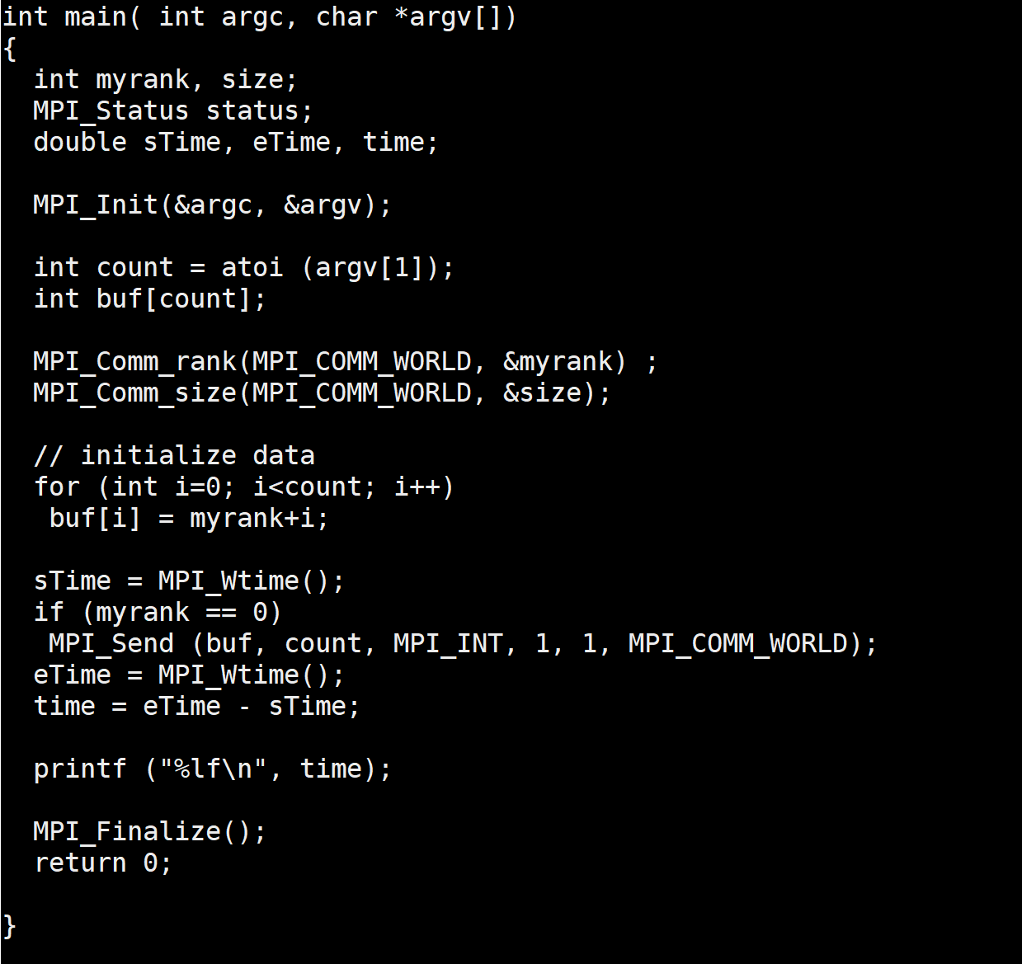
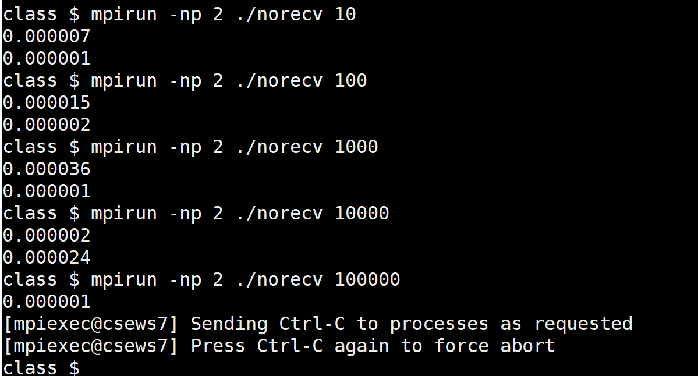
Matching MPI_Recv Not Posted
Unsafe code
norecv.c

Slide 8
Multiple Send/Recv
if (myrank == 0) {
buf[0] = 24;
MPI_Send (buf, 1, MPI_INT, 1, 1, MPI_COMM_WORLD);
buf[0] = 25;
MPI_Send (buf, 1, MPI_INT, 1, 2, MPI_COMM_WORLD);
}
else
if (myrank == 1)
MPI_Recv (buf, 1, MPI_INT, 0, 2, MPI_COMM_WORLD, &status);
printf ("%d %d\n", myrank, buf[0]);

Slide 9
Semantics of P2P
if (myrank == 0)
MPI_Send (buf, count, MPI_INT, 1, 1, MPI_COMM_WORLD),
MPI_Send (buf, count, MPI_INT, 1, 1, MPI_COMM_WORLD);
else
if (myrank == 1)
MPI_Recv (buf, count, MPI_INT, 0, 1, MPI_COMM_WORLD, &status),
MPI_Recv (buf, count, MPI_INT, 0, 1, MPI_COMM_WORLD, &status);
printf ("%d %d\n", myrank, count);
Messages are nonovertaking

Slide 10
Semantics of P2P
Order. Messages are nonovertaking:
If a sender sends two messages in succession to the same destination, and both match the same receive, then this operation cannot receive the second message if the first one is still pending.
If a receiver posts two receives in succession, and both match the same message, then the second receive operation cannot be satisfied by this message, if the first one is still pending.
-- MPI Report

Slide 11
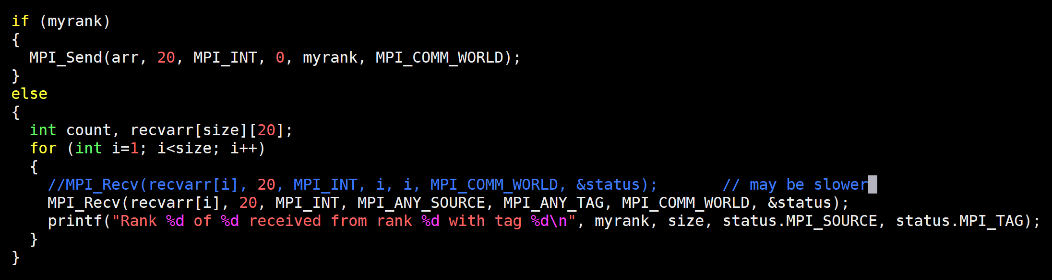
Receive Out-of-order
This may result in similar performance if MPI implementation performs buffering at the receiver side
Design MPI implementation-agnostic code
Design network-agnostic code
Design configuration-agnostic code

Slide 12
SIMD Parallelism
for i = N/P * rank ; i < N/P * (rank+1) ; i++
localsum += a[i] * a[i]
//Collect localsum, add up in one of the ranks
if (rank)
recv from all ranks (…)
else
send (0)

Slide 13
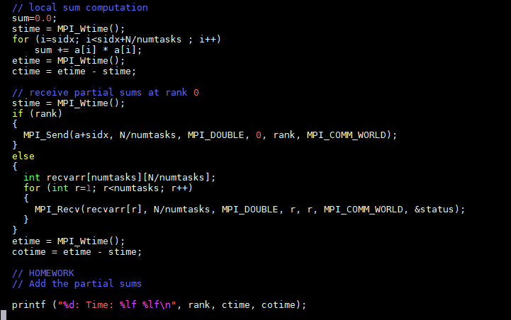
Partial Sum Recap

Slide 14
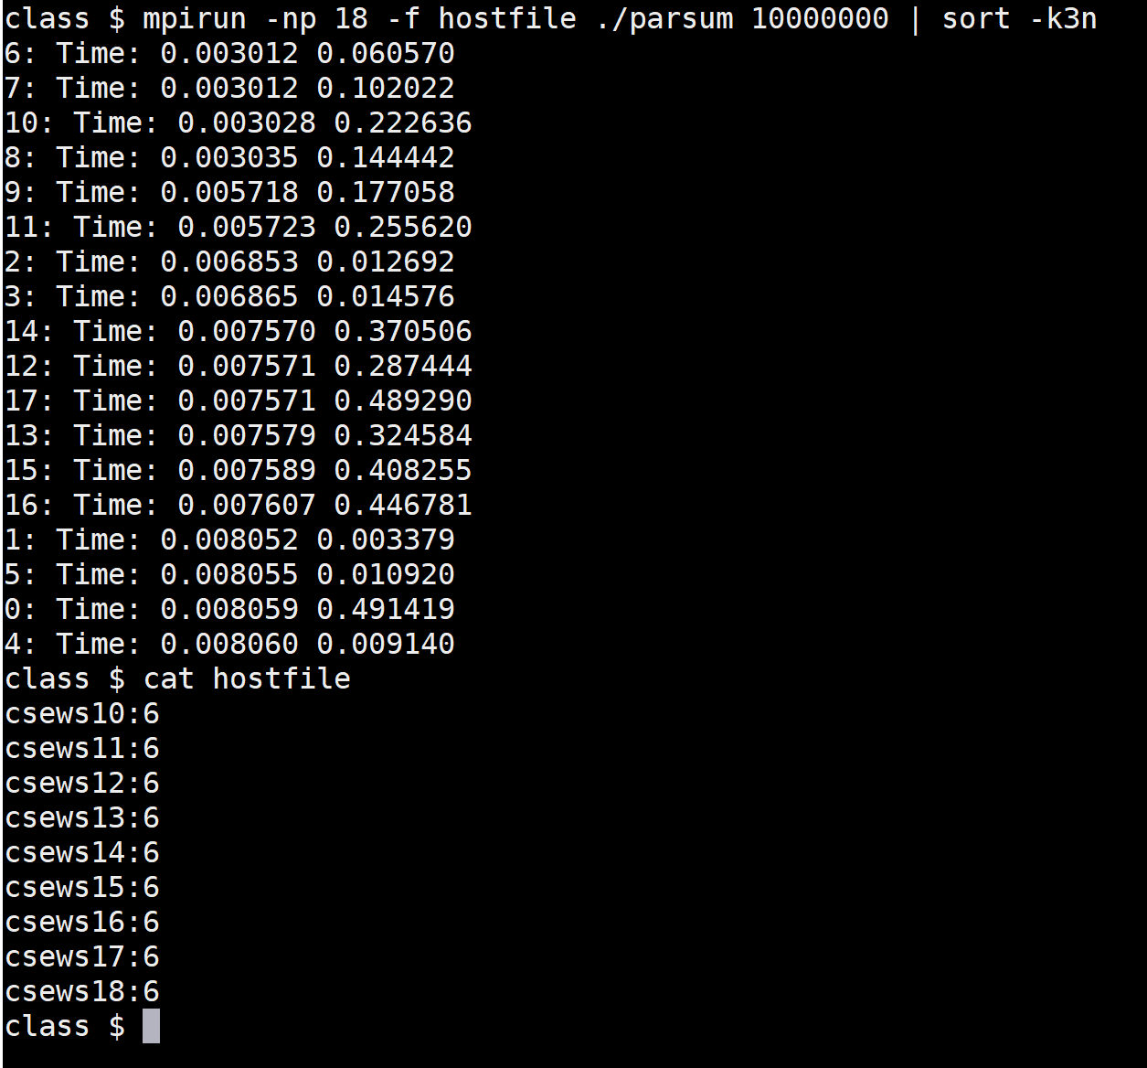

Output
Compute time
Communication time

Slide 15
Output
mpirun -np 2 ./parsum 10000
0: Time: 0.000012 0.000068
1: Time: 0.000011 0.000022
mpirun -np 2 ./parsum 100000
0: Time: 0.000113 0.000317
1: Time: 0.000114 0.000324
mpirun -np 2 ./parsum 1000000
0: Time: 0.001250 0.001951
1: Time: 0.001246 0.001941
4 processes, 10000 doubles
0: Time: 0.000006 0.000814
4 processes, 100000 doubles
0: Time: 0.000075 0.000764
4 processes, 1000000 doubles
0: Time: 0.000662 0.002383

Slide 16
Parallel Sum (Optimized)
Source: GGKK Chapter 5

